Slide 1
Notation

Slide 2
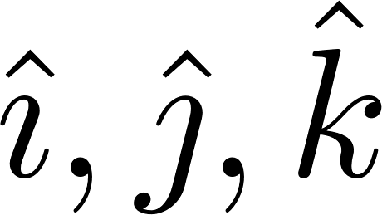
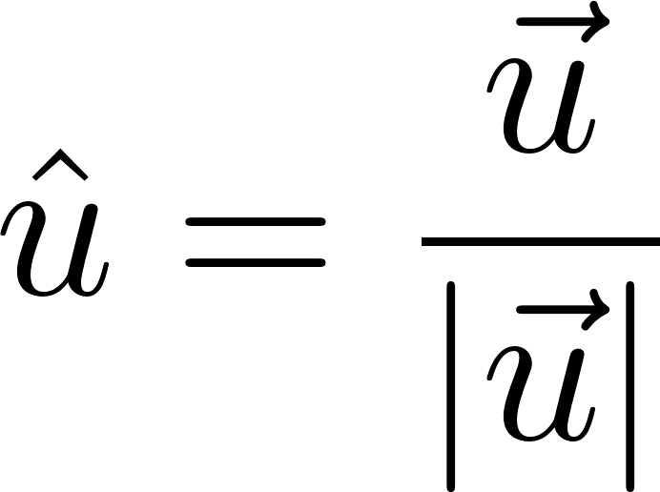
Hat Notation

Slide 3
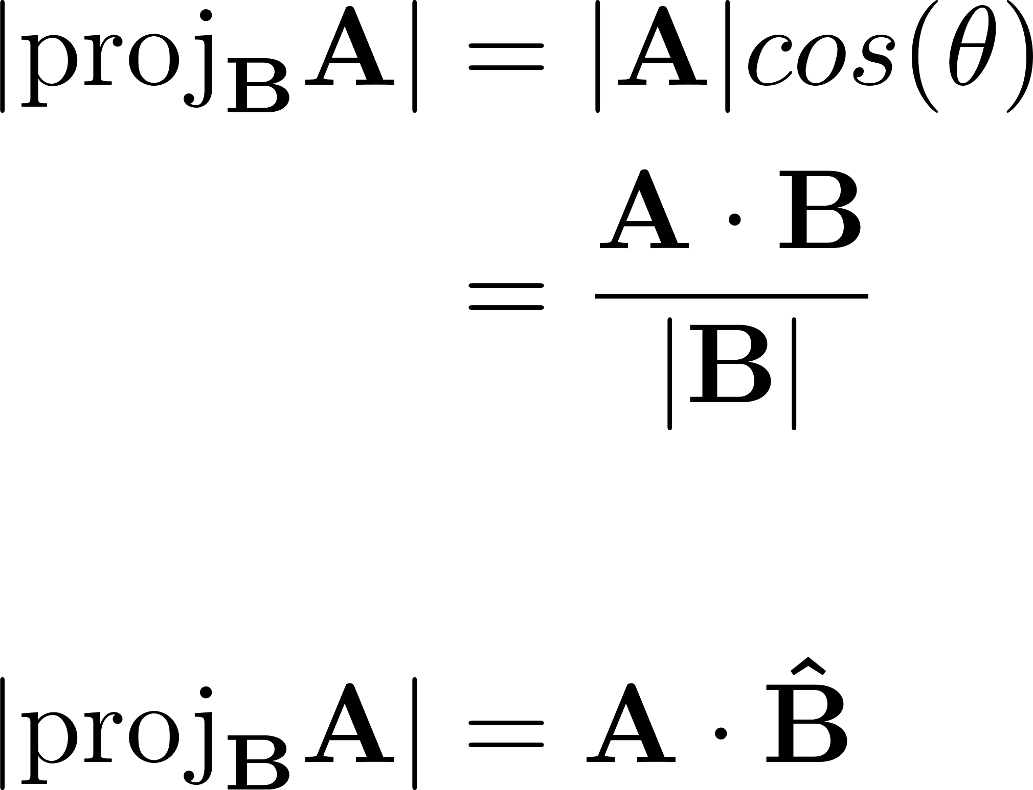
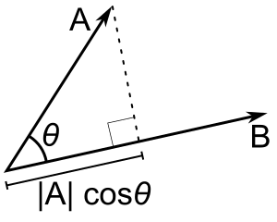
Scalar Projections

Slide 4
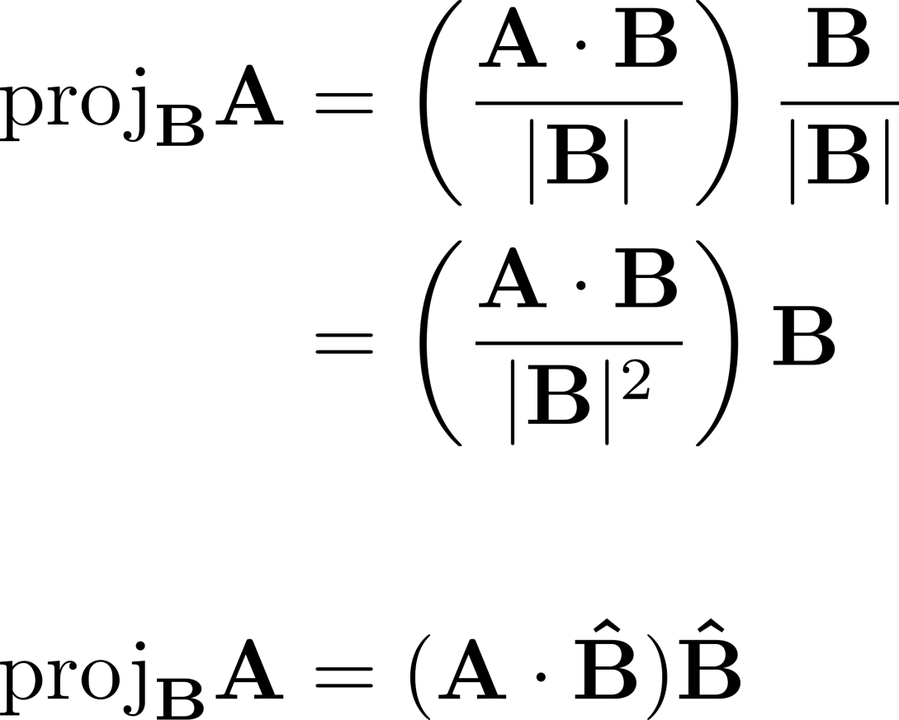
Vector Projections

Slide 5


Subscript Notation

Slide 6
Applications of Dot & Cross Products

Slide 7

Work

Slide 8
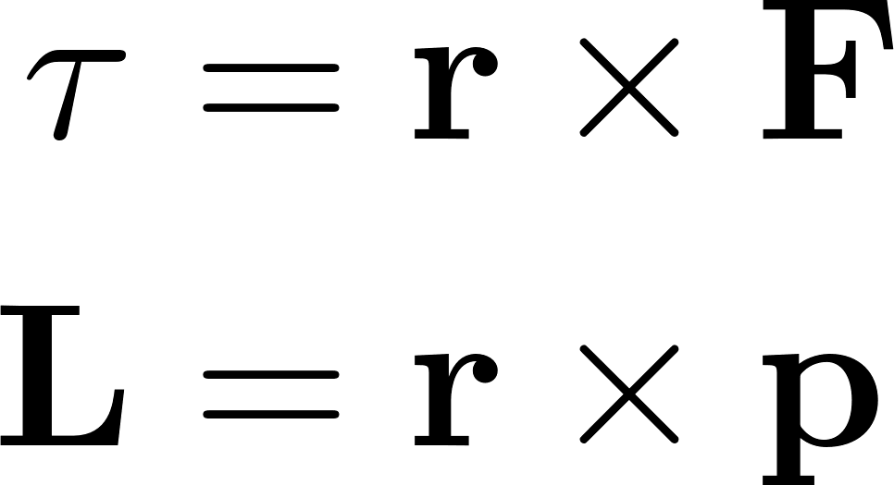
Rotational Motion

Slide 9
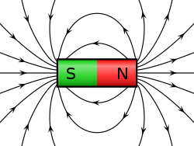

Magnetic Force

Slide 10
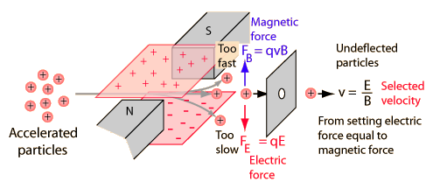
Wien Filter

Slide 11
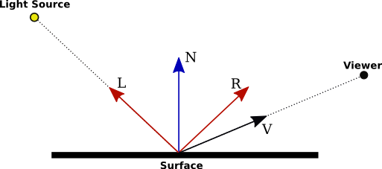
Computer Graphics & Shading

Slide 12
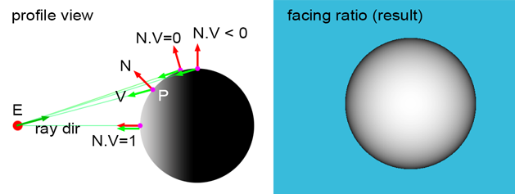

Slide 13
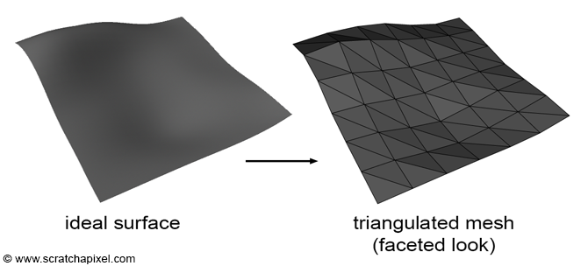

Slide 14
